Slide 1


Team Vision Team Members: 1.Piyush Kumar Das 2.Navin Kumar Barnwal 3.Vrushali Vijay Harane From-National Institute of Technology,Rourkela

Slide 2
Problem Statement:
Theme 2: To build a conversational solution that enables customers to discover and order products.
Saving their time for surfing through thousands of products on the site.
A conversational bot can satisfy the above expectation.

Slide 3
Approach:
Vision chatbot takes input in the form of search queries and the expected outcome.
Small scale E-commerce site and training set corresponding to it.
Tensorflow for Image recognition.
2-layered neural networks architecture and fundamentals of Natural language processing

Slide 4
Development Cycle
Prototyping and
Agile Model.

Slide 5
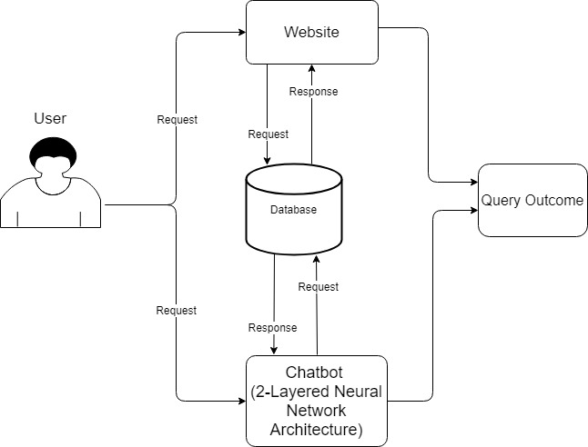
Workflow diagram

Slide 6


Technologies Used:
Programming Framework: Python, Django
Libraries used:
Tensorflow, NLTK, Numpy,
Fundamentals of Neural Networks and NLP
Front End:
HTML, CSS, Bootstrap, JS

Slide 7
Demo Video https://www.loom.com/share/32cb3d1da9ff4ef0a87058a6e7b022f5 Website link http://navinbarnwal21.pythonanywhere.com/ Github Link https://github.com/NavinKumarBarnwal/Vision (Also shared in the meeting chat)

Slide 8
Challenges Faced:
Building a training set for chatbot.
Developing an interactive user interface.
Delivering accurate results through chatbot without even going to the actual site.
Building an Image query system.

Slide 9
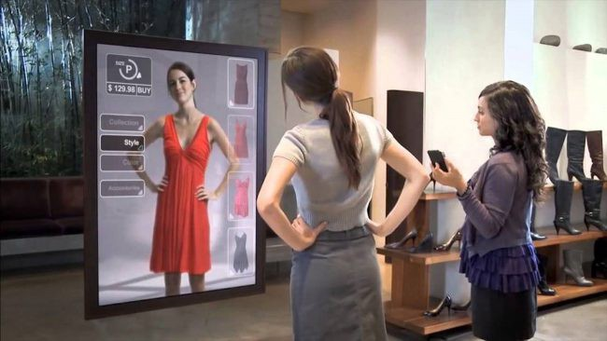
Extension of the project:
1. A virtual Image of the User after trial of the product.
This will help in decision making of the customer.

Slide 10
2. Chat analysis after specified number of queries.
After threshold number of queries if the customer is not arriving at a conclusion, chatbot will run a chat analysis.
This will tell the bot to improve the replies given to the customers so that they can get their desired outcome quickly.

Slide 11
3.Separate interface for the verified sellers for launching products
A dedicated interface for verified sellers were they can easily upload their products through chatbot.
The chatbot can also give the seller an analysis about his/her products sold on the site so that sellers can launch products according to the demand.

Slide 12
Thank You!

